Slide 1
9. Security Group

Slide 2
9-Security Group
A security group acts as a virtual firewall that controls the traffic for one or more instances.
When you launch an instance, you associate one or more security groups with the instance.
You add rules to each security group that allow traffic to or from its associated instances.
You can modify the rules for a security group at any time; the new rules are automatically applied to all instances that are associated with the security group.

Slide 3
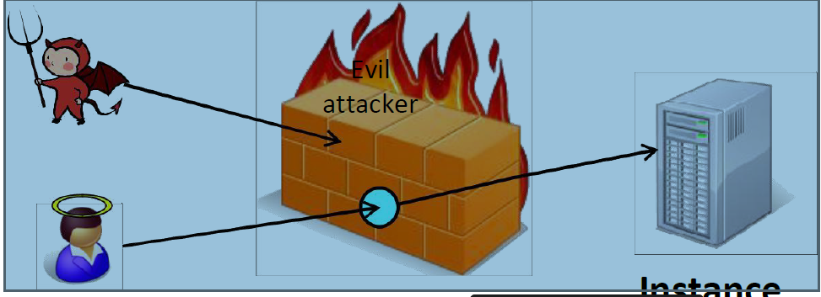
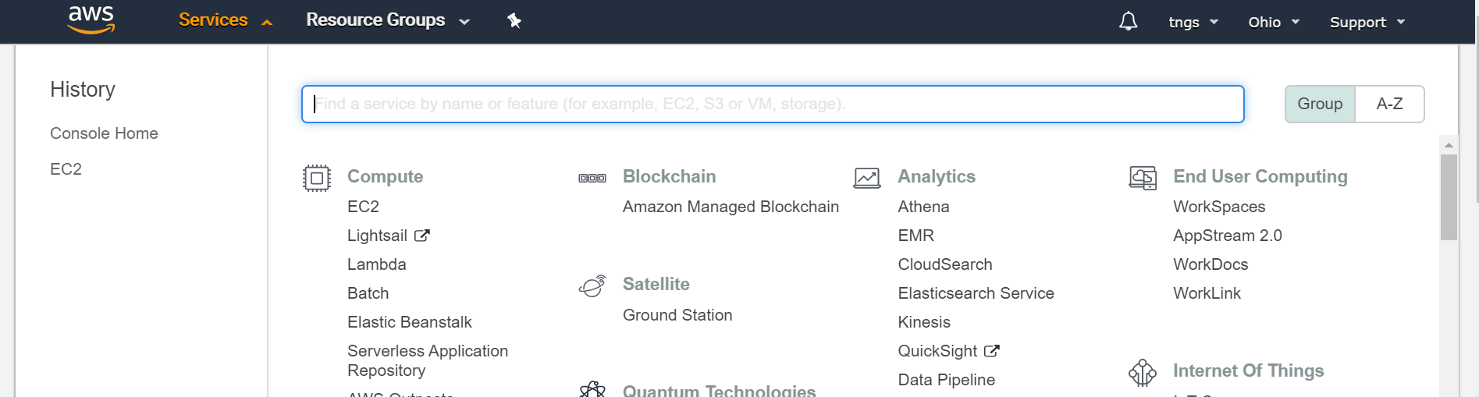
Open below URL to login to AWS console.
https://console.aws.amazon.com/
On the header of the console page, click on Services, then Click on EC2 under Compute menu.
Next, select your region from top right-side drop-down menu as shown below.
Click on Security groups section under NETWORK & SECURITY from the left pane.

Slide 4
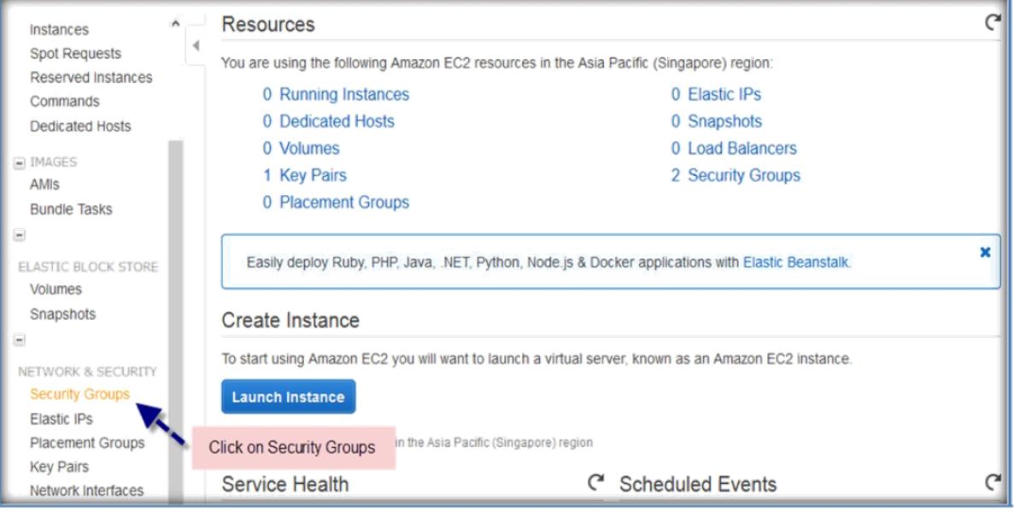
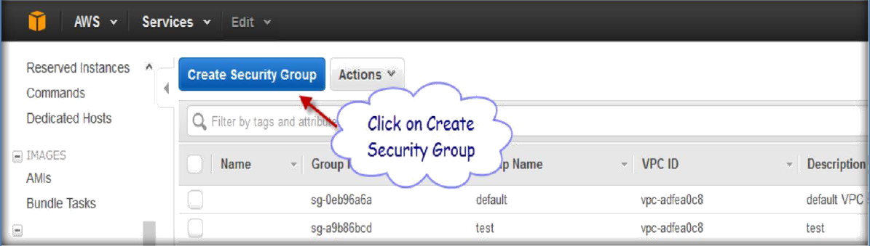
Click on Create Security Group to create a new security group.
A popup window will come then specify the Security Group name, add a description, select VPC from the VPC drop down list (It will only display VPC’s available on your region) and then click on Add Rule to add rules to your security group.

Slide 5
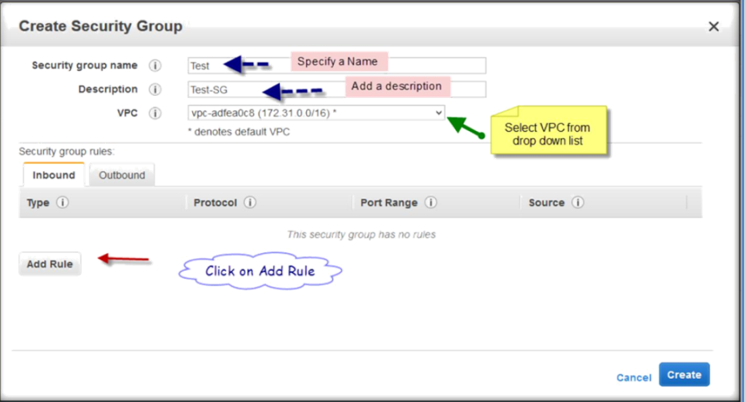
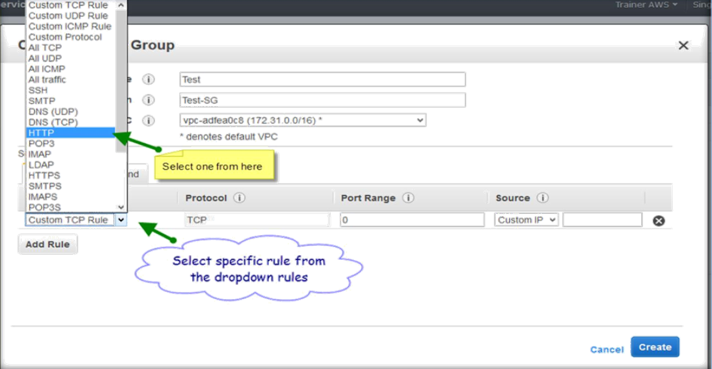
Select specific rule which is required, I selected HTTP to open 80 port on the security group.
You can either select Custom TCP rule or Custom UDP rule and specify the port which you want to open.
Or you can specify TCP or UDP and specify a range of IP addresses (20-100).

Slide 6
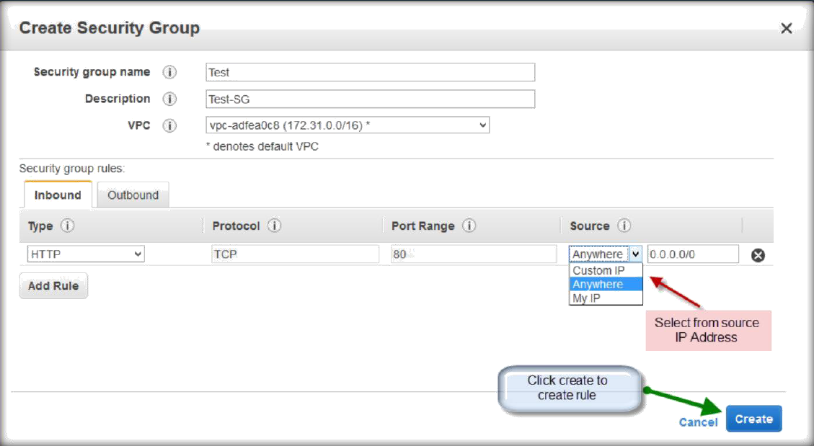
Then select source IP address from by selecting Source drop down list either Custom IP, Anywhere or My IP then click create.
The same will applies to Outbound as well, where we can restrict either by Port or by IP address.

Slide 7
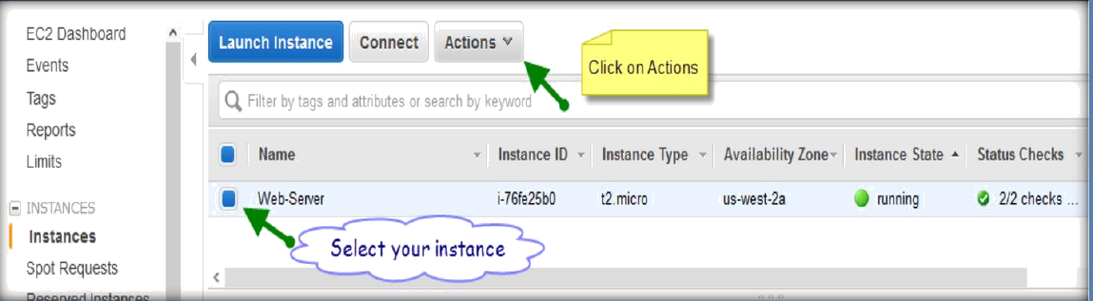
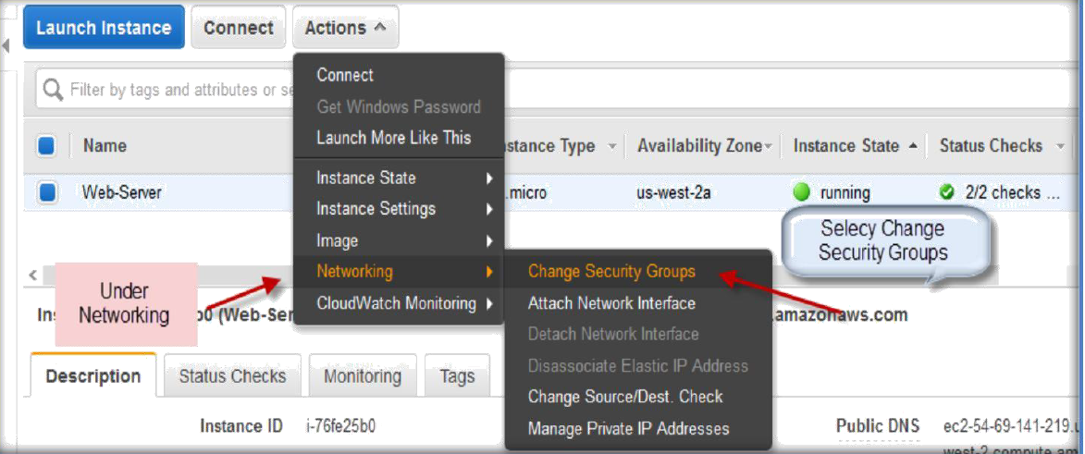
CHANGING OR ADDING SECURITY GROUPS TO YOUR EXISTING INSTANCES
Click the instance from Instance tab and select the instance, then click on Actions.
Then go to Networking and under networking select Change Security groups.

Slide 8
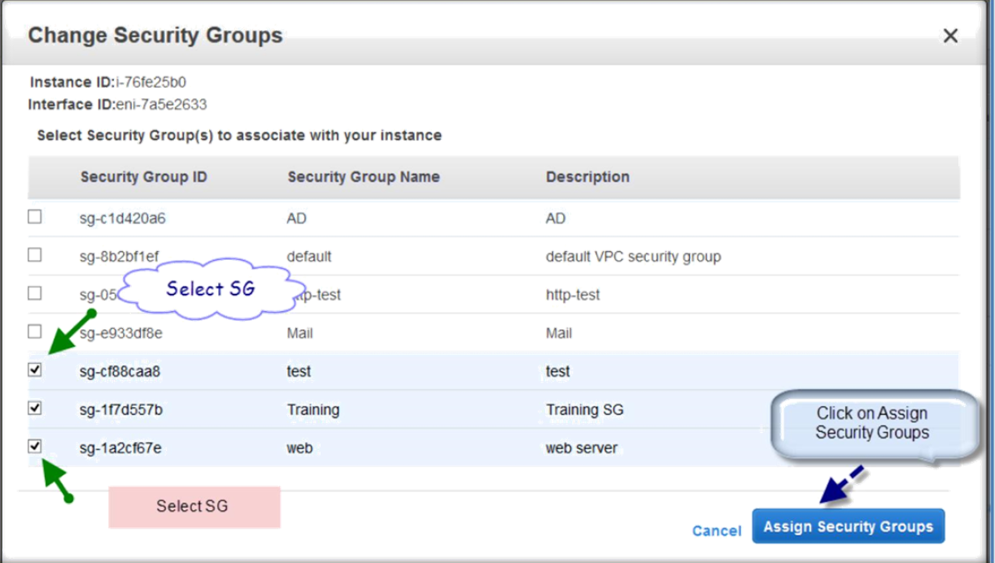
Then select Security groups from the list you want to attach or un select the security groups from the list which you want to remove from your instance.

